Slide 1

LAYOUT and MOS TRANSISTORS INTRO
ECEN 4303 Team
Teo Ene and James E. Stine
Oklahoma State University
Electrical and Computer Engineering Department
Stillwater, OK 74078 USA
james.stine@okstate.edu

Slide 2
Errors
It is no problem to help you with problems.
However, if I solve your problem, you will not learn anything.
But, please beware that its very difficult to debug over Email.
If you are remote or distance learning, call me if there is a specific problem.
If you feel uncomfortable calling me, then document your problem on piazza step by step.
Even if you call, its sometimes easier to also document your problem and then call me.
For on-campus students, please stop by and show me the problem – I will do my best to help.
Don’t give up – learn what the problem is, so you don’t repeat it.
Do not be eager to just have your problem solved!
Please do not forget to submit homework!
Suggestion: sometimes taking a 5-10 minute break on something can make night and day for any problem.

Slide 3
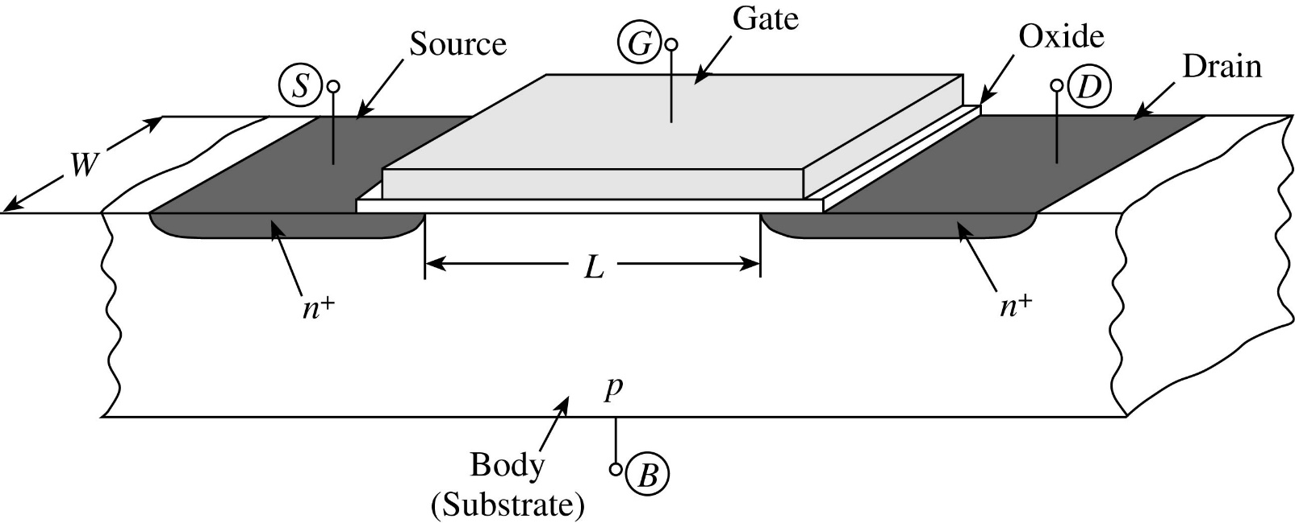
Simplified View of MOSFET
[Tsividis, McAndrew]
FIGURE 1.30 Simplified structure of an n-channel MOS transistor.
Two key design parameters : W and L

Slide 4
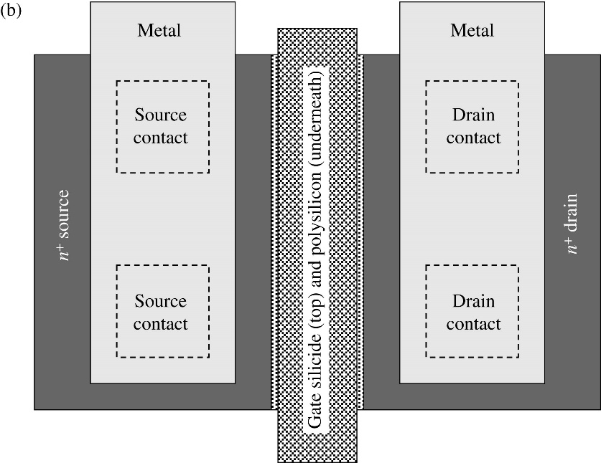
Layout
Layout is a two dimensional structure to represent the actual layout representation.
Each color represents a layer in 3 dimensions.
Its up to you to visualize the layout to organize it correctly.
However, it was the job of the Computer Engineer to program the designs into actual representable steps done by a computer.
Why?
W
[Tsividis, McAndrew]
L
Feature size or Length is quality factor on actual transistor design, since it quantifies the process in terms of a single element!
http://smithsonianchips.si.edu/

Slide 5
September 12, 2018
What does this mean?

Slide 6
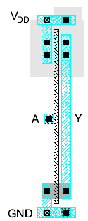
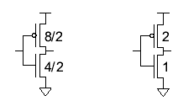
Inverter Layout
Transistor dimensions specified as Width / Length
Minimum size is 4λ / 2λ, sometimes called 1 unit
In f = 0.6 μm process, this is 1.2 μm wide, 0.6 μm long
λ = 0.3um

Slide 7
Inverter Cross-section
Typically use p-type substrate for nMOS transistors
Requires n-well for body of pMOS transistors
Passivation step in isolating circuit using SiO₂

Slide 8
Well and Substrate Taps
Substrate must be tied to GND and n-well to V_{DD}
Metal to lightly-doped semiconductor forms poor connection called Schottky Diode
Use heavily doped well and substrate contacts / taps (also called tubs)
Might be different for different technologies (e.g., twin-tub designs)

Slide 9
Detailed Mask Views
Six masks
n-well
Polysilicon
n+ diffusion
p+ diffusion
Contact
Metal

Slide 10
Metal Stack
Early processes, had only limited metal layers in their “stack” (not including poly)
Metal 1 : m1
Metal 2 : m2
Metal 3 : m3
Polysilicon or poly can be used for routing, but has higher resistance, capacitance, so should be limited in its use.
poly is on a lower level than m1
Smaller technologies have many layers of metal.
Companies may charge different rates for different stacks to help customers afford designs.
The art of layout usually involves efficiently using metal or interconnect and this is why pitch is important! (STICK DIAGRAMS!!!)

Slide 11
Inverter Mask Set
Transistors and wires are defined by masks
Cross-section taken along dashed line
2D structure

Slide 12
Important Tips!
Since wires are the contributing factor for most designs, its important you handle the designs well even at 0.5um (we use 0.6u since this is the drawn transistor length, whereas, the 0.5um is the actual transistor length).
Always assume your design is going to reuse design (hierarchy) as much as possible.
Object-oriented design.
Wires are critical, therefore, make sure you use wires as “thinly” as possible at the lowest gate level layouts.
Try not use M2 for “leaf-cell” gates! (sometimes, you have no choice).
Leaf cells are the lower-level design structures for most systems and tend to be the items most designs scrutinize to optimize.
As you lay down your wires, the following are useful paradigms.
Alternate your M1 and M2 layers in terms of methodologies even at leaf-level designs.
Use pitch as a qualifying distance for all designs! (establish design-wide parameter)
https://en.wikipedia.org/wiki/Magic_(software)

Slide 13
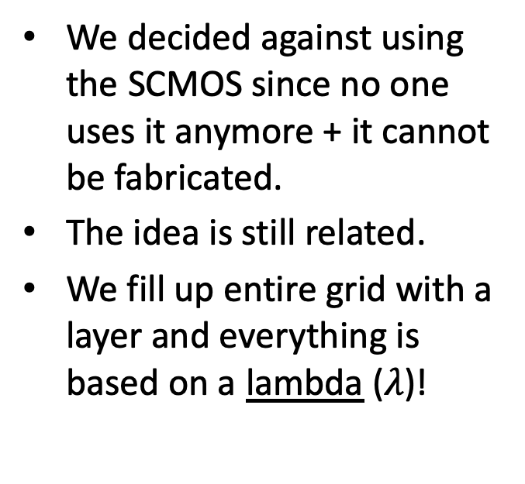
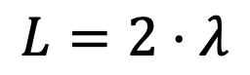
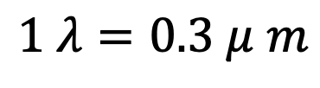
SCMOS (Scalable CMOS)
We decided against using the SCMOS since no one uses it anymore + it cannot be fabricated.
The idea is still related.
We fill up entire grid with a layer and everything is based on a lambda ($λ$)!
$$1 λ=0.3 μ m$$
$$L=2⋅λ$$

Slide 14

Interconnect
Different layers of metal are typically called interconnect, because the interconnect parts together.
However, there is different definitions on how these interconnects can connect together.
Terminology
Contact : the connection of either poly or diffusion to metal1
polycontact
ndc/pdc
Vias: the connections of metal to metal
metal1
metal2
Avoid other methods to contact wires, such as poly and diffusion – the resistance and capacitance is much higher on these layers than metal layers (they have high amounts of connectivity).
Use metals!!!!!!!

Slide 15


FOSS 130nm PDK
Cooperation between Google, Skywater Technologies, including OSU, UCSD, UMich, and others.
Goal is to create an entirely open-source Process Development Kit and flow.
Anyone should be able to jump on and create an ASIC without having to pay
We are providing them with a standard cell kit, and our general expertise
Google has already contracted a fabrication facility.
They are producing chips and badly need more designs to fabricate
It is not economical to fabricate just a few chips at a time.
Google has indicated that there is room to tape out anything we at OSU want!

Slide 16
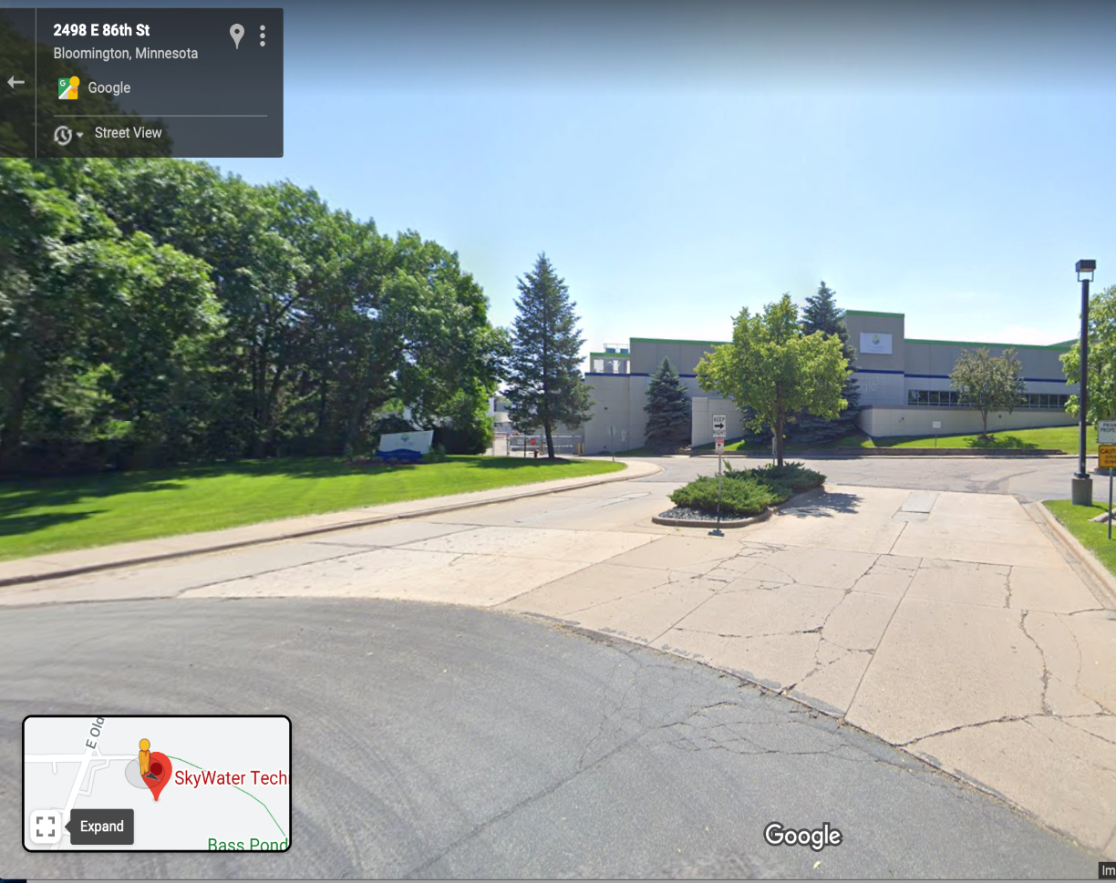
SkyWater Technologies : our Fab
SkyWater Technologies
Address: 2401 E 86th St, Bloomington, MN 55425
https://www.skywatertechnology.com

Slide 17
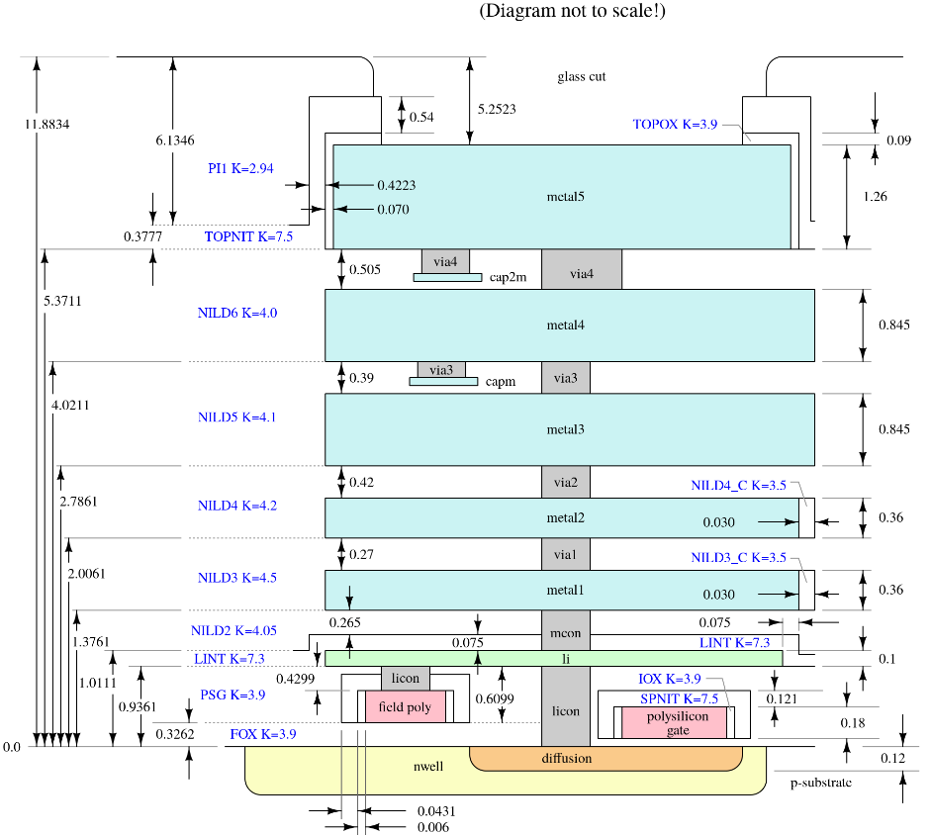
SKY130 Metal Stack
The 130nm process has 5 aluminum metal layers, as well as a high-resistance TiN “local interconnect” layer.
There are 5+1 total metal layers available.
Try to not go beyond metal2 in your designs.
li1 has a resistivity about 1/3rd that of poly, but around 100x that of m1.
In the metal stack diagram on the left, li1 comes between poly and m1.
You have to pass through it on your way up the stack.
Your design will be better if you use it sparingly.
Be creative!

Slide 18
Layer Cheat
Layer | Name
nwell | N-type well
ndiff | N-type diffusion
pdiff | P-type diffusion
ndc | N-type diffusion contact
pdc | P-type diffusion contact
nsc | N-type substrate contact
nsd | N+ substrate
poly | Polysilicon
pc | Contact from poly up to li1
locali or li1 | Local interconnect (TiN)
metal1 | Metal 1 layer
m1c | Contact from li1 up to m1

Slide 19
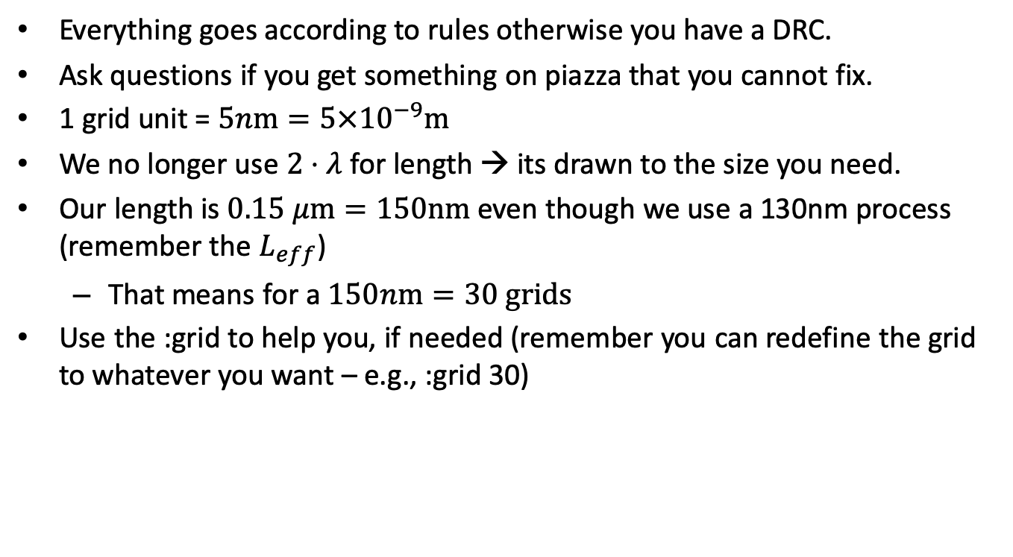
Drawing
Everything goes according to rules otherwise you have a DRC.
Ask questions if you get something on piazza that you cannot fix.
1 grid unit = $5n\text{m}=5×{10}^{−9}\text{m}$
We no longer use $2⋅λ$ for length → its drawn to the size you need.
Our length is $0.15 μ\text{m}=150\text{nm}$ even though we use a 130nm process (remember the $L_{eff}$)
That means for a $150n\text{m}=30 \text{grids}$
Use the :grid to help you, if needed (remember you can redefine the grid to whatever you want – e.g., :grid 30)

Slide 20
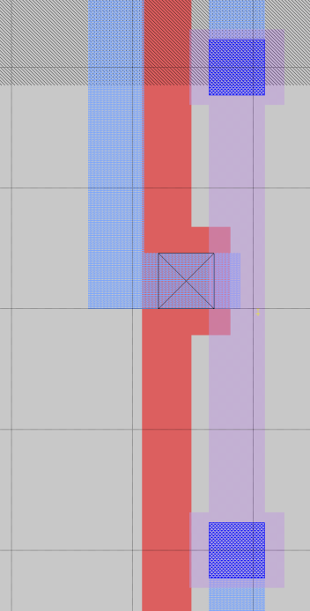
Design specifications
In this 130nm process, as is the norm in more advanced processes, vias require overhang.
Examples can be seen on the right.
The spice models for this technology are currently being updated.
As of right now, only a discrete list of transistors can be correctly modeled.
Lengths should be 0.15um (the minimum)
Widths should be either 0.42um, 0.55um, 0.64um, 0.84um, 1um, 1.26um, 1.68um, 2um, or 3um
We are updating the wiki to contain all this information.
Do not worry about remembering this! Use the wiki as a reference while you work!
We will also add an inverter tutorial for 130nm
Restrictions encourage creativity ☺

Slide 21
Steps in Design
Synthesis of Integrated Circuits – forward motion in design!
Design Flow
What is it all about?

Slide 22
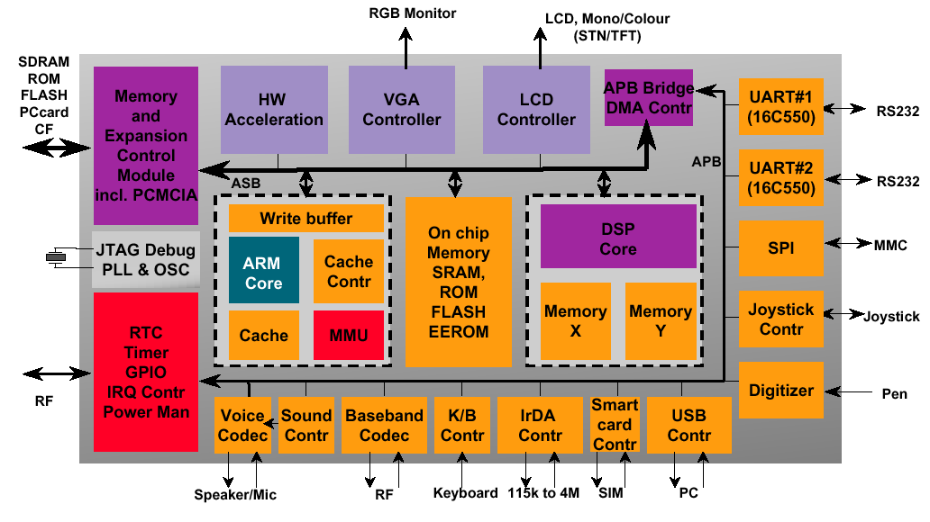
System on a Chip (SoC)
[ARM]
This is not any different than putting together several devices on one breadboard!
Notes:
Many systems include Analog and Digital functions.
This course will deal only with digital designs.

Slide 23
Design Flow
Design flow is important, because it makes a viable path towards a mask.
More information on Canvas
EFS8A
A mask is the format which is uploaded to the machines that represents layers in three dimensions.
gds2 (CALMA) – most popular format as it’s a binary format and can easily be secured cryptographically.
Represented by a number from 0 to 255 (8-bits).
cif (Caltech Interchange Format) – the format we will use in this class (text-based and output of Magic by typing :cif).
Each layer is defined by three letter designator for each and every layer.
Extra layers not utilized for mask machines are removed.
e.g., CPG = polysilicon

Slide 24
Scripts
Scripts simplify life pure and simple.
A good script is easy to use, well documented, and useful.
We use one I created that students enjoy using over the last couple of semesters.
ext4mag file.mag
This script will take a magic file and extract it to give you its .gds, .sim and optionally its SPICE deck (more on SPICE later).
For now, you can respond “N” when asked if you want to generate SPICE.
Feel free to modify – you can find its location by typing:
which ext4mag

Slide 25
Layout
Magic
Output to CIF
Use your stick diagrams!
Printing of Magic – always pplot (please do not use screen shots!)
Pplot translates CIF layers into postscript output that can be inserted into documents or printed to PDF.
http://vcag.ecen.okstate.edu/wiki
ps2pdf ./file.ps

Slide 26
Verification
Verification is the process of going back from a stage in the design flow to actually figure out what is happening and whether you are on the right track.
All tools use netlist-to-netlist design stages!
Schematic entry is utilized to guarantee designs are actually what they are designed for.
Design for Manufacturing (DFM)
DRC – Design Rules Check – guaranteeing layout obeys rules.
LVS – Layout vs. Schematic – guaranteeing schematic is actually what its supposed to be.
ERC – Electric Rules Check – guaranteeing actual design meets electrical reliability rules (e.g., Wells are attached properly).

Slide 27
Never forget LVS!
Never forget LVS – it guarantees you are on the right track.
Certain companies have “grounds for dismissal” in their contracts for missing LVS!
LVS should be used after every cell passes DRC.
Use it as a debugging feature as designs are attached one-by-one.
It also is a check on whether you are doing things correctly.
Starts with the schematic – this is usually done first at most companies.
Schematics can be textual
Hardware Descriptive Languages (HDL)
SPICE files
MultiSim from National Instruments

Slide 28
Design Flow
Create Schematic
IRSIM : switch-level simulation (schematic)
SPICE : circuit-level simulation (for sizings)
Create Stick Diagram
Design Layout
DRC
LVS (always!)
IRSIM : switch-level simulation (layout)
SPICE : circuit-level simulation of extracted layout (for timing/power)
Plot of layout (pplot)
Note: Hardware Descriptive Languages (HDLs) have overtaken simulation of operation (and initial timing) as they easy to use and repeat!

Slide 29
Summary
We have a modified version of the flow that we have used in the past.
We will explore this new addition to hopefully help you get better ideas about how to create layout with better EDA software.
The new tool is called Mentor Graphics Calibre
It is an industry-standard EDA tool and seems to work very well for what we need.
Use scripts and command files to simulate things easily and repeatedly.
Good use of scripts can save groups several hours of work!
Let’s be creative and have fun!!!!

